Slide 1
DermAI
Navigating skin health with advanced tech solutions

Slide 2
Table of Contents
01
02
05
03
06
04
Introduction
Overview of the team
Unpacking the dermatological demands of the current era
Problem & Solution
Technology stack
Spotlight on existing dermatological care gaps
Unveiling the platform
Dissecting the free vs pro versions
Technologies to be used in the platform
Sample interface (Built with StreamLit)
Value proposition
Market analysis
Highlighting user benefits
Differentiation from current market solutions
Estimated user base potential
Projected market growth
Sustainability and Monetization
Revenue stream details
Future growth zones

Slide 3
01
Introduction

Slide 4
Overview of the team
Our team is composed of four dynamic individuals with diverse backgrounds in technology and science. Rohan, an esteemed alumnus of IIT Hyderabad, brings with him a wealth of experience, particularly from his internship at ISRO where he worked on CNN-based satellite image classification. His tenure at Baker Hughes further honed his expertise as he delved into document classification, automation, and extraction using NLP techniques. Amritha's trajectory in the startup ecosystem as a software developer has been inspiring, endowing her with hands-on experience in a fast-paced, innovation-driven environment. Aravinthan is currently an intern at IISC, where he is making significant contributions to projects involving scheduling and the operation of diffusion furnaces—a testament to his analytical prowess and problem-solving skills. As for myself, I am further augmenting my skills through an internship at IIITB, where I am actively engaged in a project focused on database sustainability. This experience is enriching my understanding of sustainable practices in database management and adding a practical edge to my academic knowledge. Our connection with Rohan began through LinkedIn, leading to a fruitful collaboration in a hackathon. This event was not just a meeting of minds but also an alignment of visions, which has since led to a productive three-month-long working relationship. Although my classmates and I have been collaborating on projects throughout our college tenure, our collective synergy has reached new heights with Rohan's addition to the team.

Slide 5
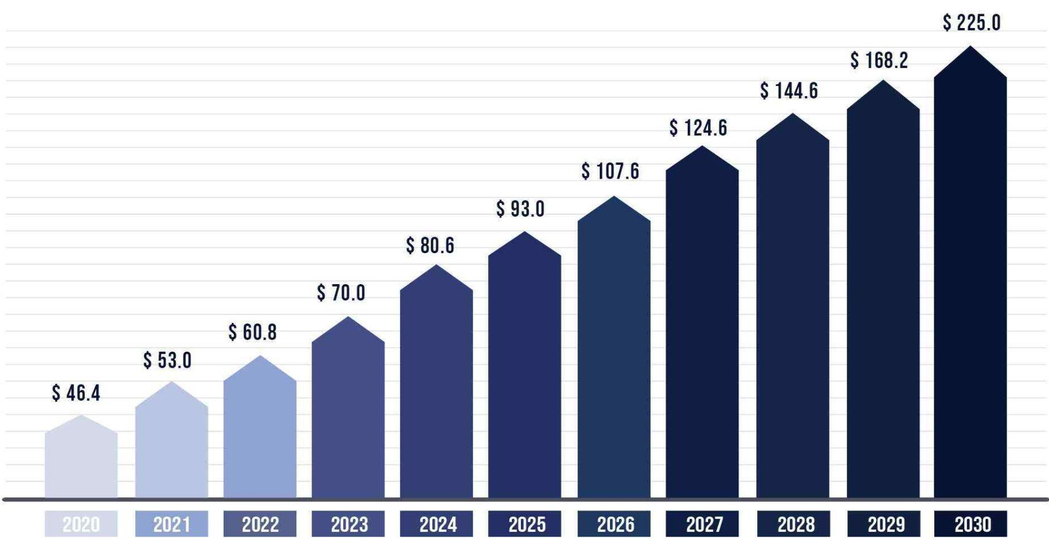
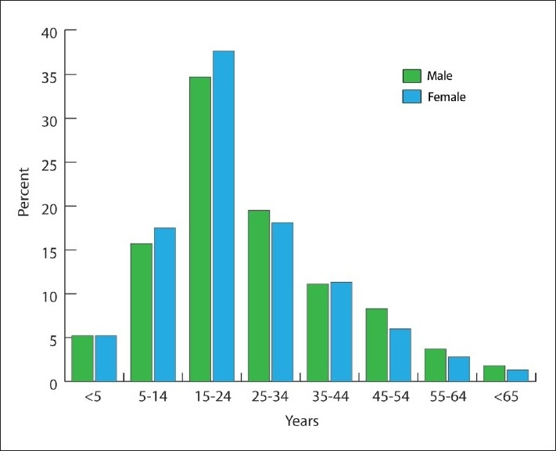
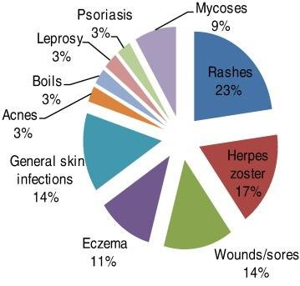
Unpacking the dermatological demands of the current era
Telemedicine market size, 2020 to 2030 (USD BILLION)
Frequency of affected people of different skin diseases in India, 2015
Overall ranking of skin disease with respect to Age and Gender in the Qassim region of Saudi Arabia
Source:
Dermatology Endoscopy Devices Market Size, Report 2032 (precedenceresearch.com)
The pattern of skin diseases in the Qassim region of Saudi Arabia: What the primary care physician should know (researchgate.net)
Pharmacological Strategies Used in Treatment of Skin Diseases (researchgate.net)

Slide 6
02
Problem & Solution

Slide 7


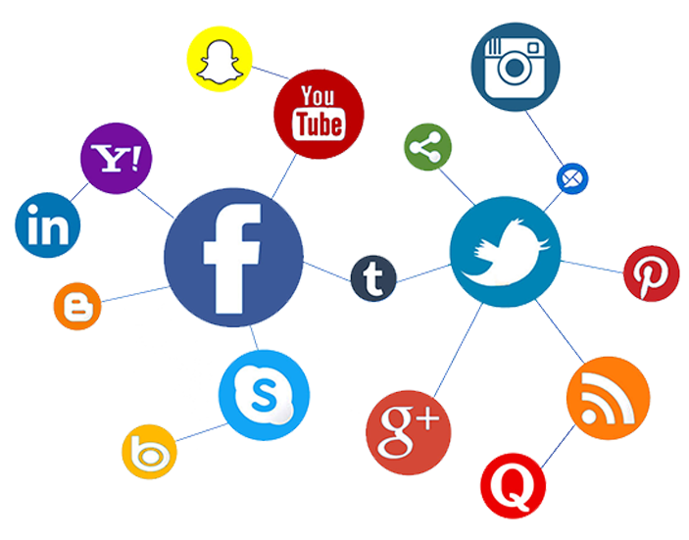
Spotlight on existing dermatological care gaps
With the rise in environmental pollutants, changing lifestyle habits, and increased awareness, people are more concerned than ever about their skin health. According to a recent study published in the Journal of the American Academy of Dermatology, the demand for dermatological services has surged, outpacing the growth of the dermatologist workforce
(Source: "Supply and Demand for Dermatologists in the United States: A Workforce Analysis" - JAAD, 2023).
The advent of social media and its influence on beauty standards has escalated the focus on flawless skin, creating an amplified demand for dermatological services. A survey by the Dermatology Times reported that 55% of dermatologists saw an increase in consultations due to patients becoming more self-conscious from social media images
(Source: "Social Media’s Impact on Dermatology and Aesthetics" - Dermatology Times, 2023).

Slide 8
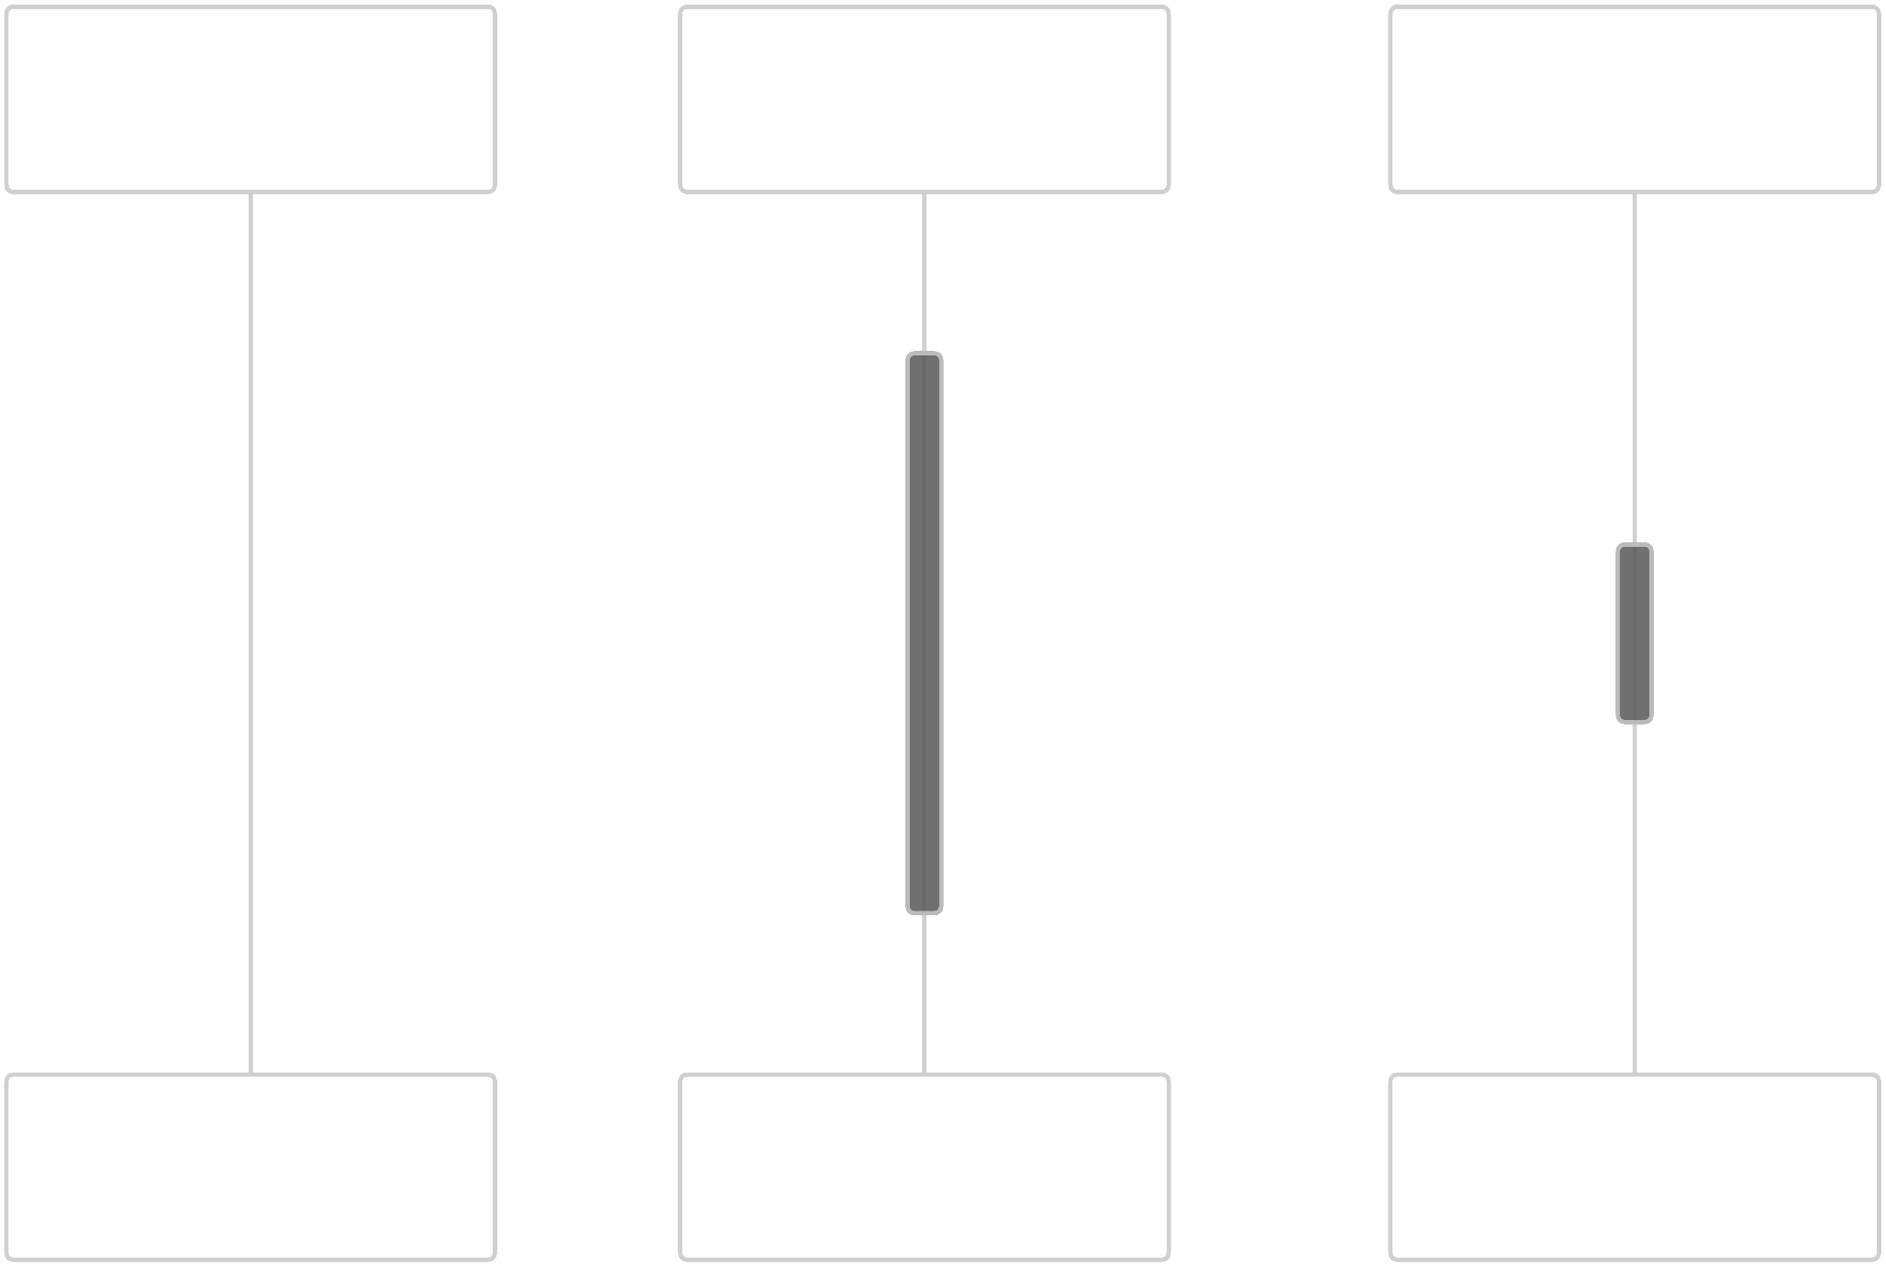
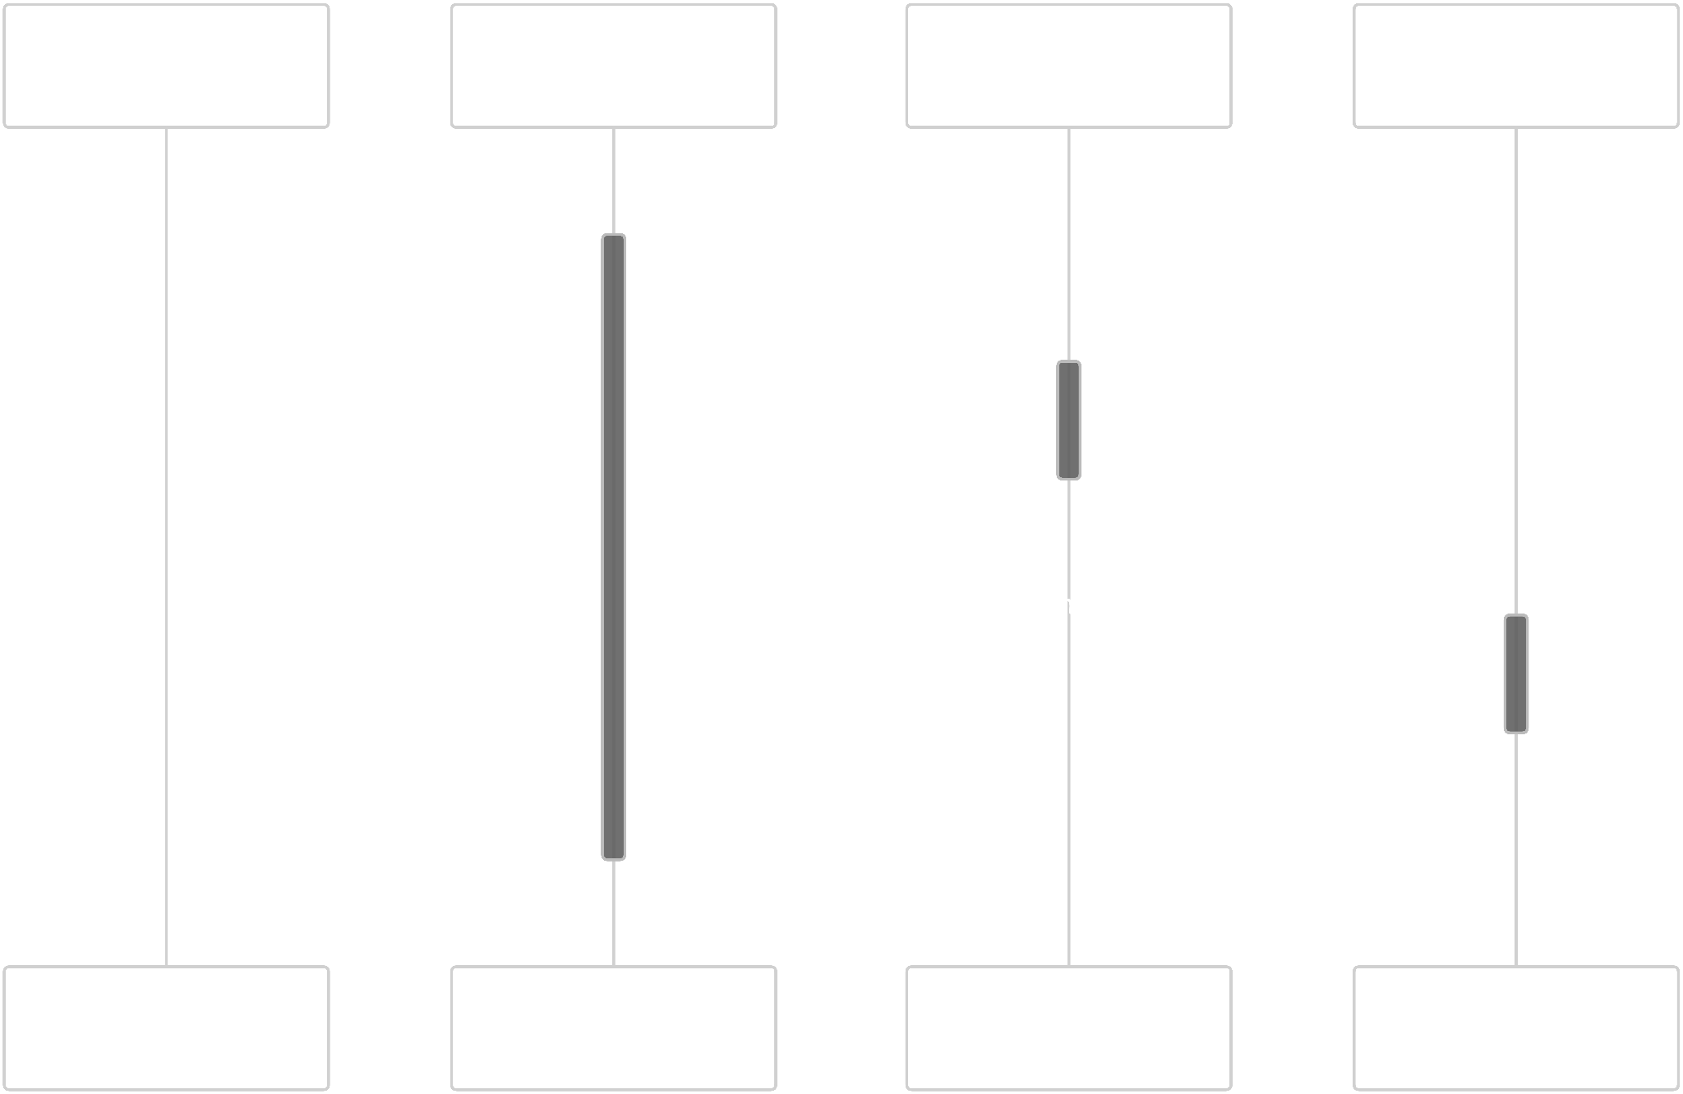
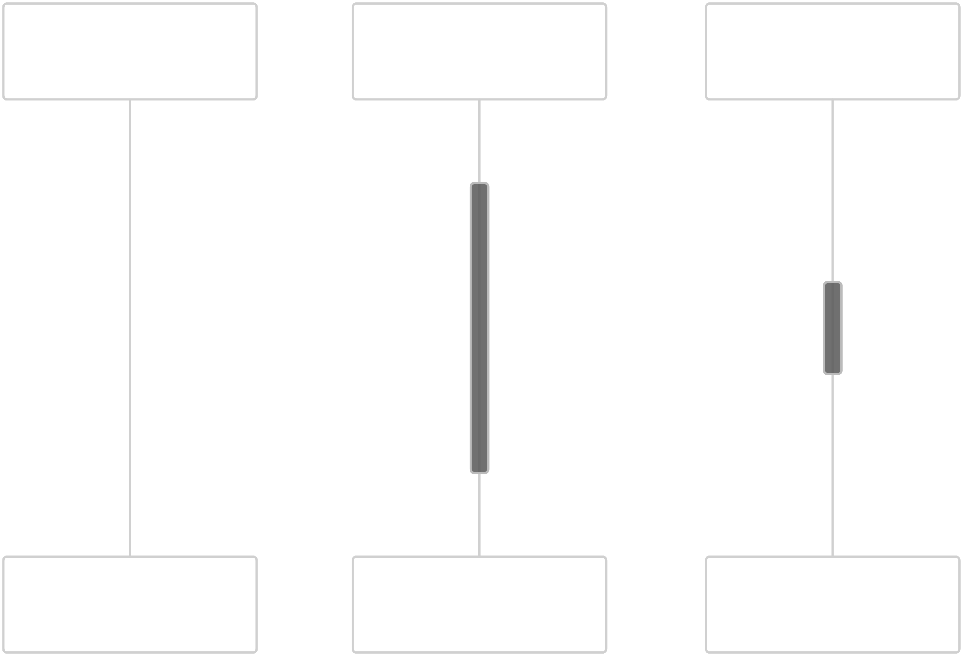
Unveiling the platform
Advanced Chatbot (GPT-4 32k Context):
Tailored Skincare Regimen:
Advanced Image Processing:
A digital platform offering immediate, accurate skin health assessments and personalized dermatological advice using advanced AI.

Slide 9
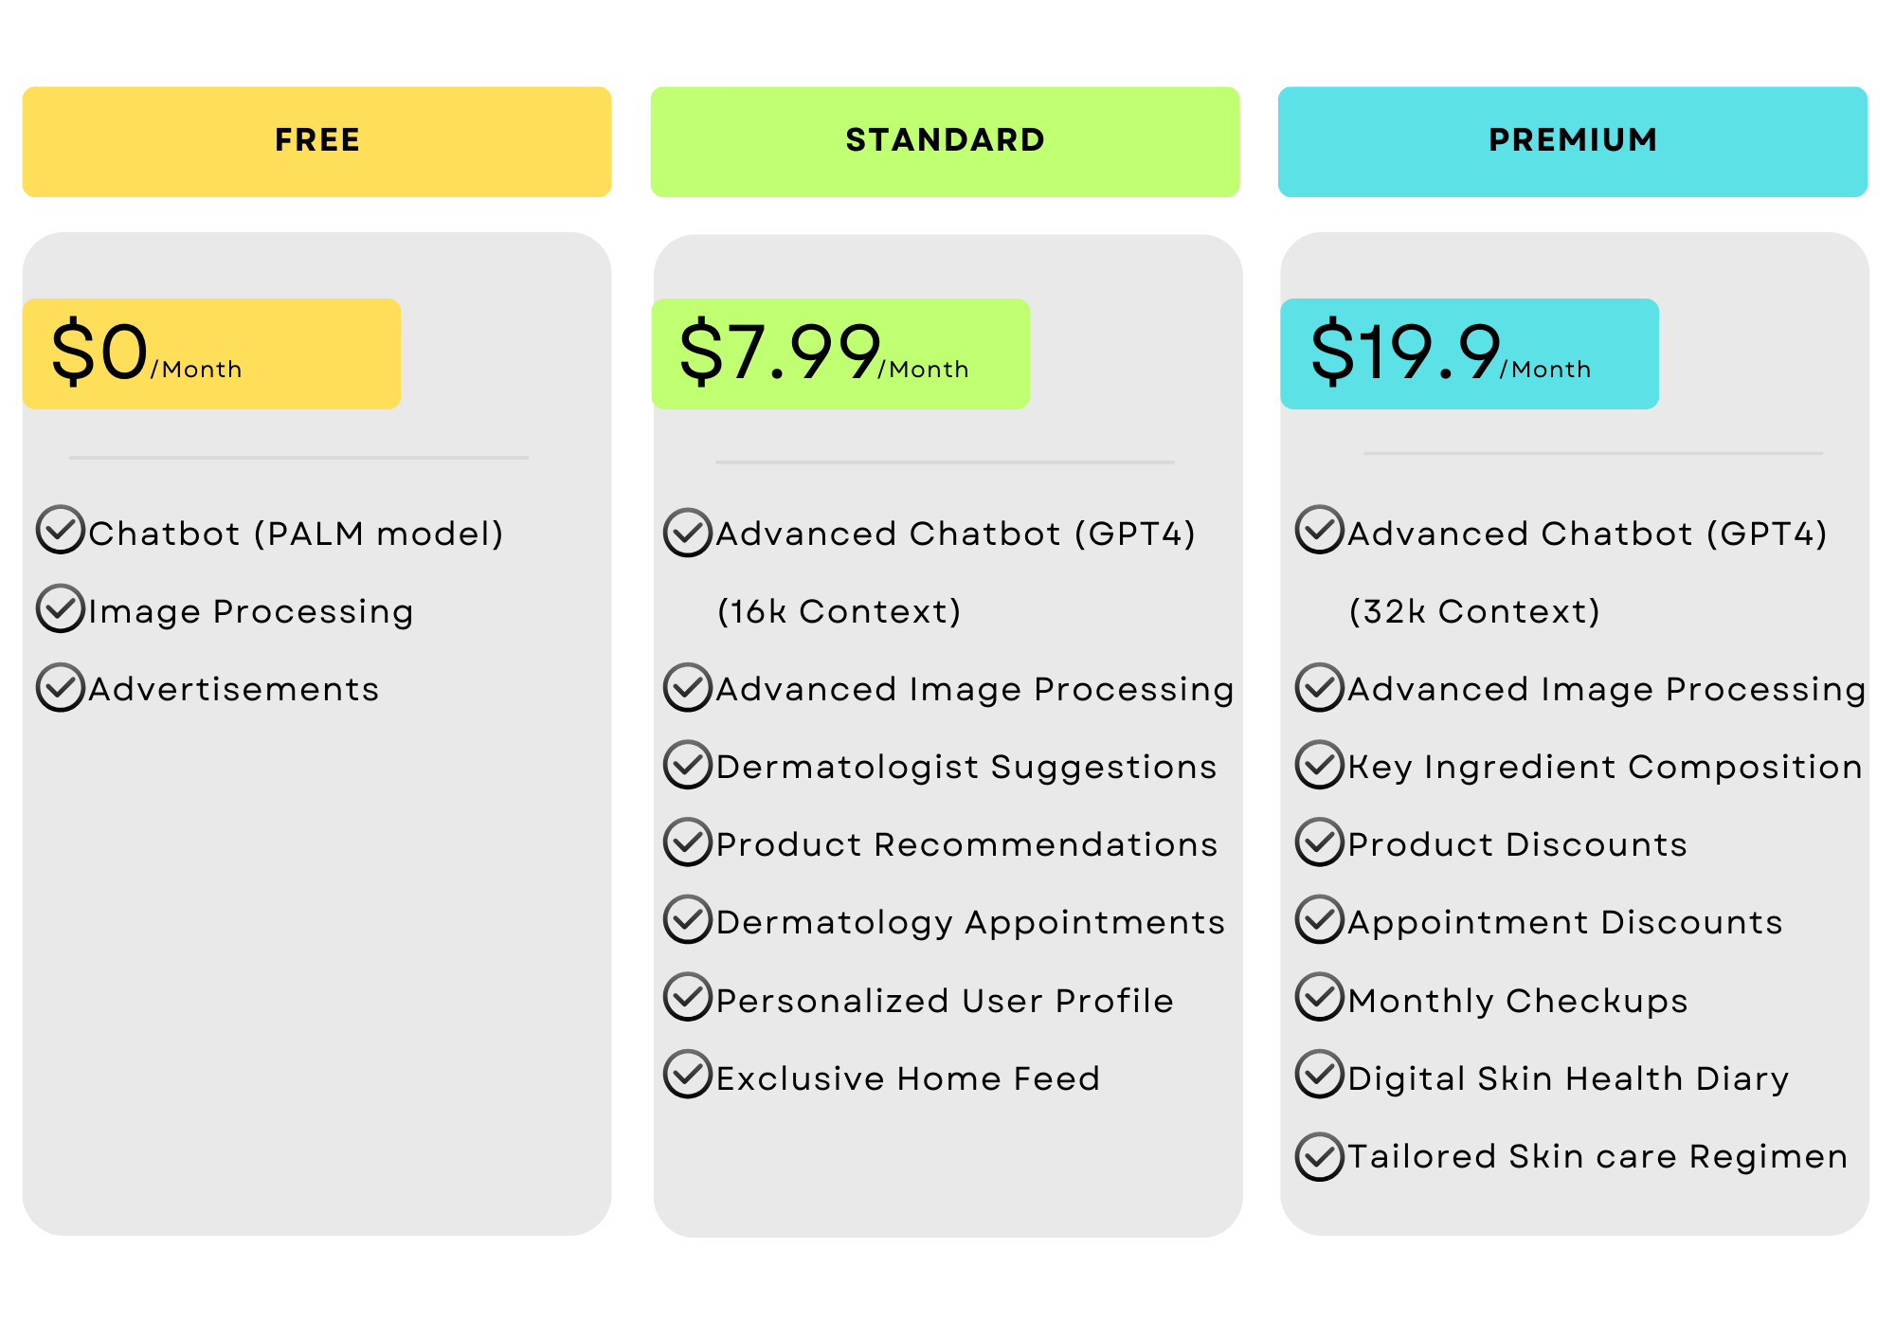
Dissecting the free vs pro versions

Slide 10
03
Value proposition

Slide 11
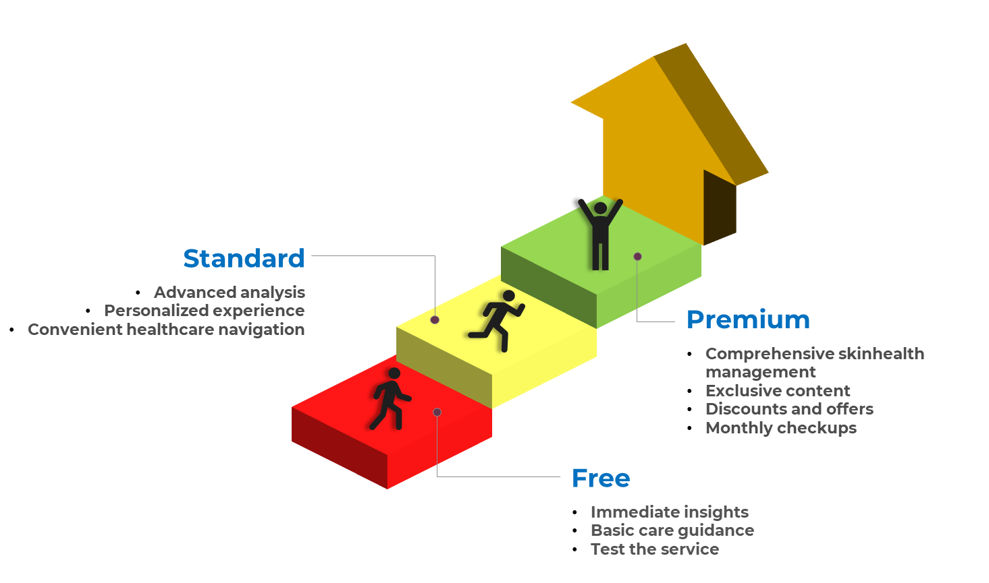
Highlighting user benefits

Slide 12
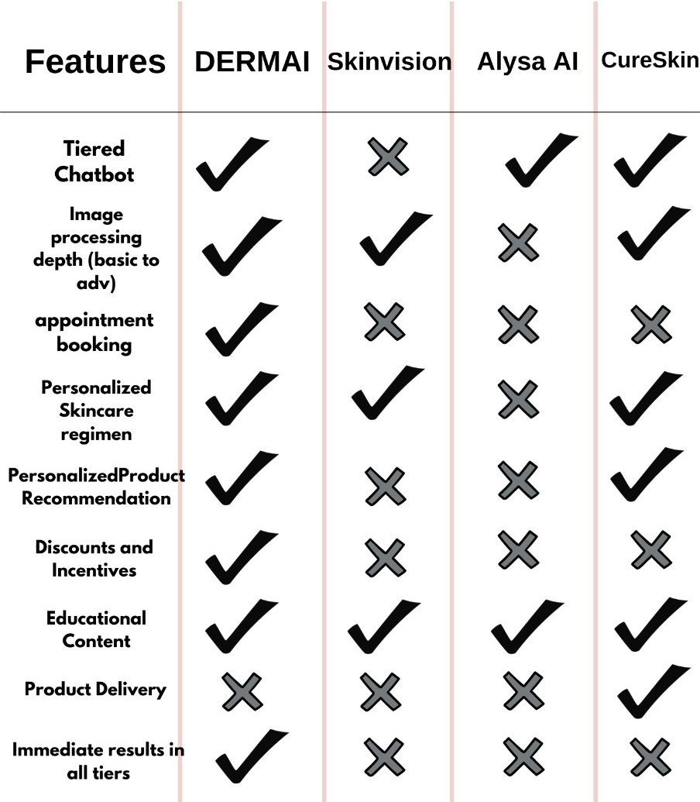
Differentiation from current market solutions

Slide 13
04
Sustainability & Monetization

Slide 14
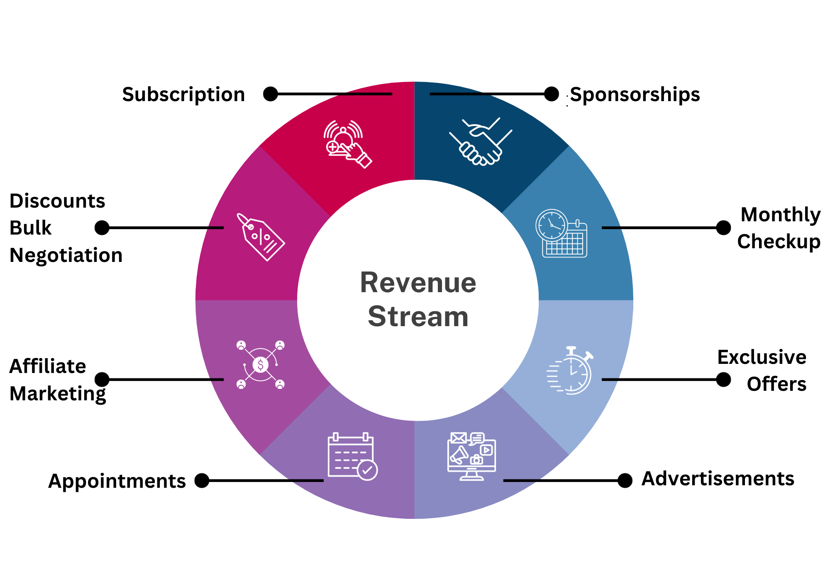
Revenue stream details

Slide 15
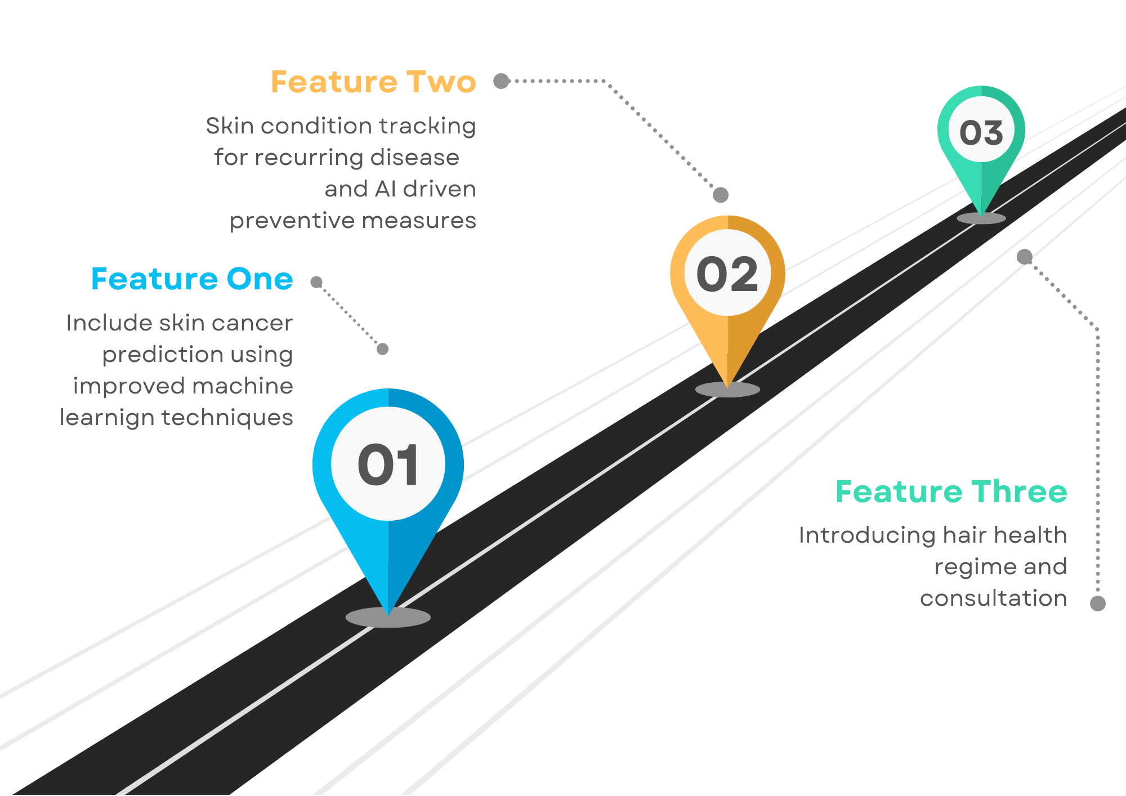
Future growth zones

Slide 16
05
Technology stack

Slide 17
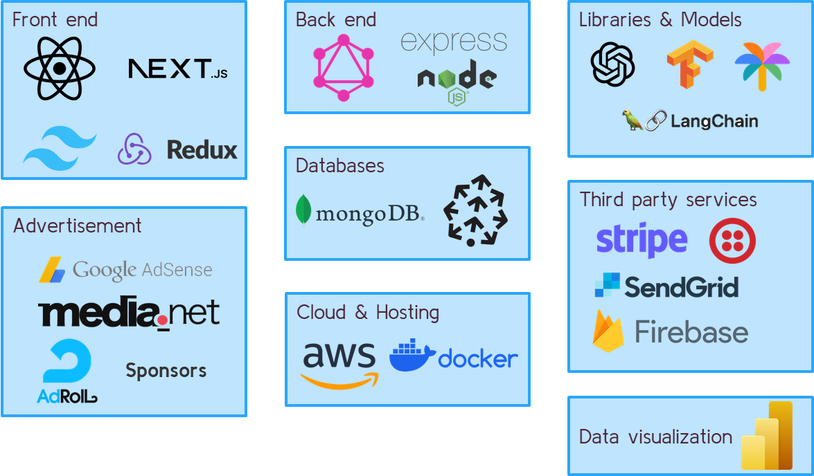
Technologies to be used in the platform

Slide 18
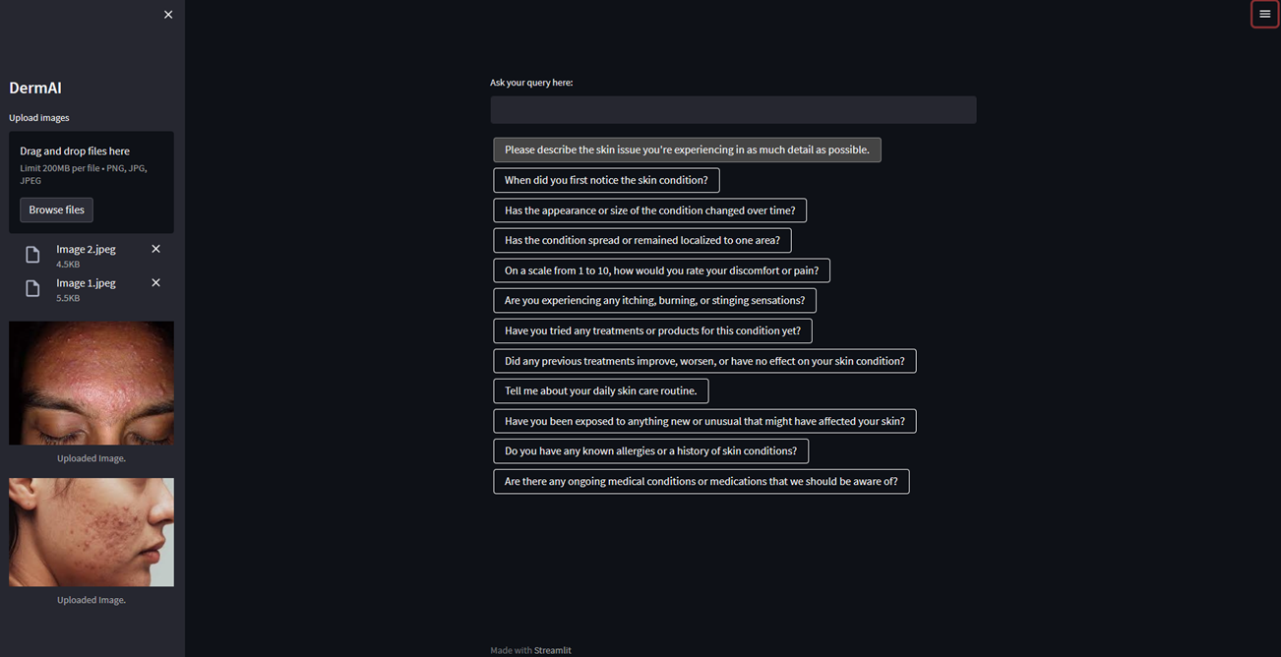
Sample interface (Built with StreamLit)

Slide 19
06
Market analysis

Slide 20
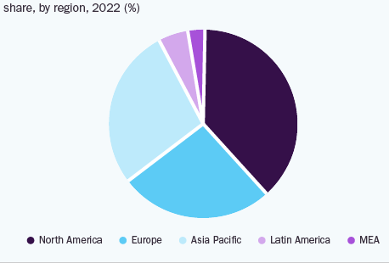
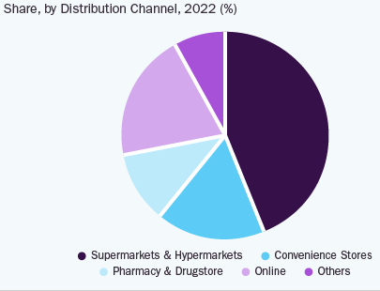
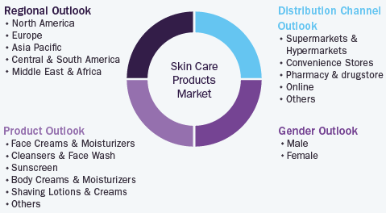
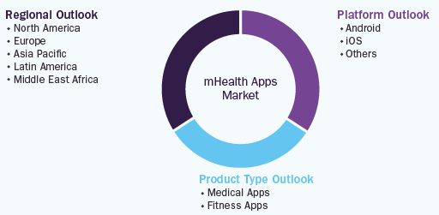
Estimated user base potential
$43.5B - Global mHealth apps market size, 2022
$135.8B - Global market size, 2022
Report segmentation - 14+ Number of Countries Covered in the report
Report segmentation of mHealth Apps Market
Source: Skin Care Products Market Size And Share Report, 2030 (grandviewresearch.com)

Slide 21
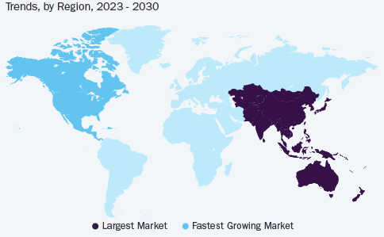
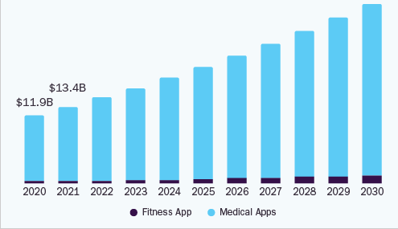
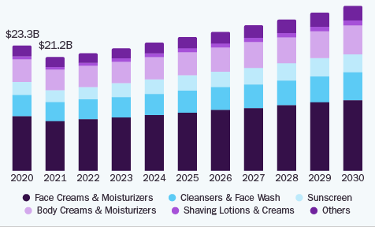
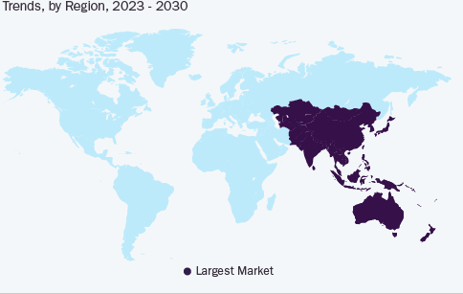
Projected market growth
39.6% - Asia Pacific Market Revenue share, 2022
9.5% - US mHealth Apps Market CAGR, 2023 - 2030
43.0% - Asia Pacific Market Revenue share, 2023 - 2030
4.2% - US Market CAGR, 2023 - 2030
Source: Skin Care Products Market Size And Share Report, 2030 (grandviewresearch.com)

Slide 22
07
Conclusion & Future roadmaps

Slide 23
Vision for the long haul
Becoming a Global Standard: Strive to make the platform the go-to digital solution for skin health assessment globally. This includes continuous improvements to maintain the highest standard of accuracy in image processing and the most responsive AI through regular updates and upgrades.
Expansion of Services: Plan for the future expansion of our services, including the integration with health trackers and other IoT devices for real-time skin health monitoring, and potentially developing a mobile app to increase accessibility and convenience.
Long-Term Health Tracking: Integrate long-term health tracking and predictive analytics to forecast potential skin and health issues before they become serious, using historical user data for better outcomes.
Research and Innovation: Continuously invest in research and innovation, keeping abreast with the latest developments in dermatology, artificial intelligence, and imaging technology to keep the platform ahead of the curve.

Slide 24
Strategy for scaling and enhancements
Feature Development:
AI Enhancements: Regularly train the AI models with new data to improve accuracy and introduce new features.
Personalization Algorithms: Develop algorithms to provide personalized content and product recommendations.
User Experience Improvements:
Feedback Loops: Implement mechanisms for users to provide feedback on their experience and suggest improvements.
Internationalization:
Multi-language Support: Ensure the platform supports multiple languages to cater to a global audience.
Integration with Health Systems:
Electronic Health Records (EHR): Integrate with EHR systems to provide a more comprehensive health overview for users.
Wearable Integration: Develop compatibility with wearable devices to track skin health over time.
Technology Stack Upgrades:
Latest Tech Implementation: Keep abreast of new technologies and frameworks that can improve platform performance and features.
Technical Debt Management: Address technical debt to prevent it from hindering new feature development or scaling efforts.

Slide 25
Thanks!
Please keep this slide for attribution

